Slide 1
VERIDI LOGISTICS DELIVERY PERFORMANCE AUDIT
Prepared by: Ushaw Seiba
AmaliTech Data Analytics Capstone Project
Tools Used:
Python (pandas,numpy, seaborn and matplotlib)
GitHub
Power BI (dax)

Slide 2
Problem Statement
Veridi Logistics observed an increase in negative customer reviews and suspected that inaccurate delivery estimates and delayed deliveries were affecting customer satisfaction.
Project Objectives
Evaluate delivery performance.
Identify regions with high late-delivery rates.
Assess the impact of delivery delays on customer reviews.
Develop an interactive dashboard to support business decision-making.

Slide 3
Data Preparation & Methodology
Dataset Used
The dataset was downloaded from Kaggle
and sourced from the Olist Brazilian E-Commerce Dataset.
Data Sources
The analysis utilized multiple relational tables, including Orders, Customers, Reviews, Products, and Product Category Translation datasets.
Order_Items Dataset

Slide 4
Data Preparation & Methodology
Data Preparation
Merged multiple datasets using order_id and customer_id.
Handled missing values.
Converted date columns to datetime format.
Translated product categories from Portuguese to English.
Feature Engineering
Created:
Days_Difference
Delivery_Status
Late_Flag
Late Delivery Rate
On-Time Delivery Rate

Slide 5
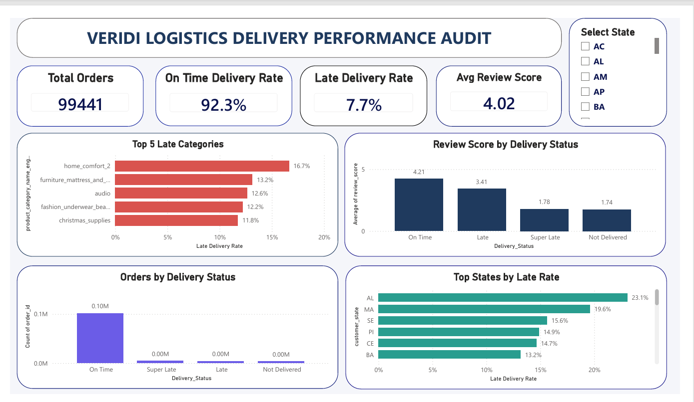
Dashboard Overview
Dashboard Components
Total Orders
On-Time Delivery Rate
Late Delivery Rate
Average Review Score
Top 5 Late Categories
Top States by Late Rate
Review Score by Delivery Status
Orders by Delivery Status

Slide 6
Key Findings
Delivery Performance
Total Orders: 99,441
On-Time Delivery Rate: 92.3%
Late Delivery Rate: 7.7%
Geographic Analysis
Certain states recorded significantly higher late-delivery rates, indicating regional delivery challenges.
Product Categories
Home Comfort, Furniture & Mattress, and Audio products experienced the highest delay rates.

Slide 7
Customer Satisfaction Analysis
Review Scores by Delivery Status
Average Review Scores:
On Time: 4.21
Late: 3.41
Super Late: 1.78
Not Delivered: 1.74
Key Insight
Customer satisfaction decreases significantly as delivery performance worsens.
This confirms that delivery delays are a major driver of negative customer reviews.

Slide 8
Recommendations & Conclusion
Recommendations
Improve logistics planning for high-risk product categories.
Focus operational improvements on states with high delay rates.
Improve delivery monitoring and tracking systems.
Reduce delivery delays to improve customer satisfaction.
Conclusion
Veridi Logistics demonstrates strong overall delivery performance; however, targeted improvements in specific categories and regions can further reduce delays and improve customer experience.
Thank You.

